Slide 1
Laptop Prices Models
Kyle Brinker

Slide 2

Goal
Predict the latest price for a laptop based on the specifications of the Computer.

Slide 3
Variables for Formula [1]
Predictors Included:
Graphics Card Gigabyte
Warranty
Old Price
Brand
Apple, Alienware, Smartron, HP, or ASUS
Number of Stars
Ratings
No touchscreen
Processor
AMD, Intel, or M1
Processor Generation
4^{th,} 7^{th,} 8^{th,} 10^{th,}12th
Ram
4 GB, 8 GB, or 16 GB
Ram Type
LPDDR4 or LPDDR3
SSD
0 GB, 128 GB, 256 GB, 512 GB, 1 TB, 2 TB
HDD
0 GB, 512 GB
DOS OS
Screen Size
13.3”, 13.4”, 14”, 14.1”, 14.2”, 15.6”, 16”, 16.2”
Weight (Gaming)

Slide 4


Previous Results[1]
Full Model
Reduced Model

Slide 5
New Models
Decision Tree
Random Forest
Naïve Bayes

Slide 6

Decision Tree
Produced Significantly Better Results Than Other Models

Slide 7
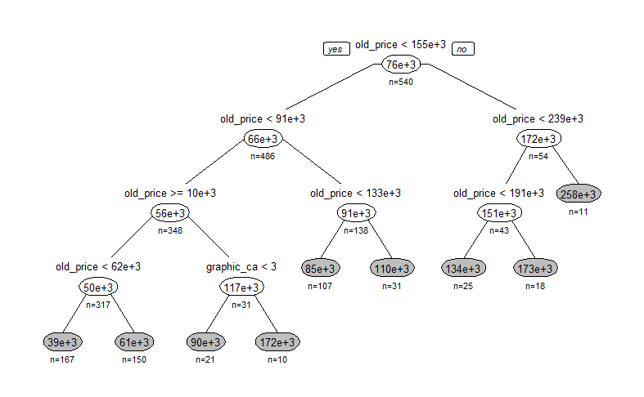
Decision Tree Visualization

Slide 8

Random Forest
Produced Worse Results (Possibly Due to Overfitting)

Slide 9

Naïve Bayes
Also Produced Worse Results

Slide 10
Conclusion
Model Choice: Decision Tree
Produced the Lowest RMSE value (20114.45)
Next Steps:
Use Binning Techniques to Improve Accuracy
Normalize the Data

Slide 11
References
[1] Brinker, K. (2024, March 5). Term Project Step 2.
[2] Huang, B. (2024a, April 4). RandomForest.
[3] Huang, B. (2024b, April 9). Naive_Bayes.
[4] Make.names: Make syntactically valid names. RDocumentation. (n.d.). https://www.rdocumentation.org/packages/base/versions/3.6.2/topics/make.names
[5] Kumar, S. (2022, April 3). Laptop specs and latest price. Kaggle. https://www.kaggle.com/datasets/kuchhbhi/latest-laptop-price-list?rvi=1
[6] Machine Learning for Business Analytics: Concepts, techniques, and applications in R, Second edition. (2023). . John Wiley and Sons Ltd.

